Slide 1
Intro To Tank Days

Slide 2
What do I do on tank days?
Record your data on your individual log book in Google Drive
Help your group get their tank data if needed
If you need to do a water change, yes that is the ecologists job, but they will need your help.
Enjoy having a fish and being in Aquatic Science class.
Admire other tanks.

Slide 3
Botanist
Observe characteristics, behaviors of organisms and plants. You are recording:
Type of plant(s)
How many leaves plant(s) has per week
Height of plant(s)
Average leaf width
Account for new leafs as they grow
Record and graph all data in your designated Google Docs

Slide 4
Veterinarian
Observe feeding and behavioral patterns. You are recording: Observe behavior for EACH fish: Watch for at least 15 min increments per week to observe
Typical tendencies (schooling, bullying, hiding, chasing, etc.)
Male or female* If species are known to have change sex
Eating patterns
Record / blog all data in your designated Google Docs

Slide 5
Ecologist
You are recoding eating patterns, performing and recording all water changes, in charge of checking all equipment weekly. Your recording:
Dates of water changes
Dates of filter changes
Dates of added water due to evaporation
Amount of tank supplies your group has and notify group when stocks need to be replenished well in advance of running out
Dates of equipment checks:
Heater, filter, lights, thermometer, overall inspection of tank.
Record and graph your data with all chemist data in your designated Google Docs
Water Changing Video: Click Here

Slide 6
Zoologist
Observe characteristics and behaviors of organisms including fish and plants. You are testing:
Type of Fish
Size of fish
Sex of the fish
Fish Diet
Record and graph all data in your designated Google Docs

Slide 7
Chemist
Chemical testing on water. You are testing:
pH / **High pH
Ammonia
Nitrites
Nitrates
Temperature
**salinity
Record and graph all data in your designated Google Docs
**Salt-water tanks
Water Testing Video: Click Here

Slide 8
Daily duties/responsibilities
Feed your fish between bells (before the bell rings at the beginning of class or after the bell rings at the end of class)
Generally, one pinch of food is enough food for the entire tank
Make sure you have a group text started because when the person who normally feeds the fish is absent they can be fed.

Slide 9
Rules in the Aquarium
Feed fish between bells
Stay out of others tanks (even if they gave you permission)
Feed only your OWN fish
No food, drink, or backpacks in the lab
Wash your hands if you have been in the tank, and keep your hands out of your eyes, nose, ears, and mouth.

Slide 10
Lab Day: things to check
Label all cords
Make sure they have a loop in them
Check and see if there are enough outlets/ power cords and they are mounted correctly!
Your tank has:
Filter
Heater (in the box)
Thermometer (or pink sticker on your tank by your tank #)
Working lights

Slide 11
When can you get fish?
When your nitrogen cycle is circulating
Your chemist will be able to tell you
When you have a plant in your tank
When you have at least 2 filter replacement pieces
Fish food (depends on fish and you can get this when you buy your fish)
Salt** (if your tank needs salt)

Slide 12
What to expect this week?

Slide 13
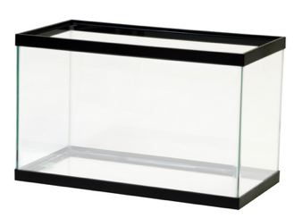
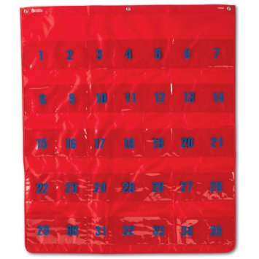
Thursday
Nitrogen Cycle Quiz
Being decorating tank background & tank box

Slide 14
Friday
First 20 min finish backdrops
Being Blackfish
Look for bias statements
Questions what you are told
Write down questions you have about facts!
Why Blackfish?

Slide 15
Monday
Continue Blackfish
Look for bias statements
Questions what you are told
Write down questions you have about facts!

